Slide 1
FAIR Data Train overview EJP-RD Distributed Analysis Work Focus October 23, 2023
Faculty of electrical engineering, mathematics and computer science
Semantics, cybersecurity and services group
Luiz bonino

Slide 2
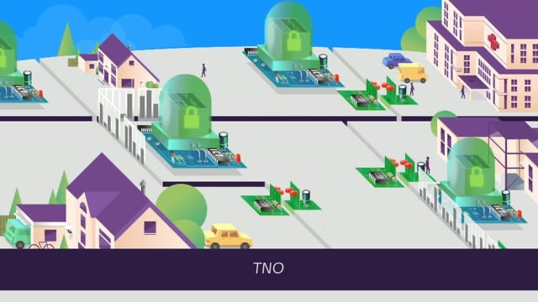
Personal health train
http://vimeo.com/143245835

Slide 3
FAIR Data Train
Based on the ideas of the Personal Health Train
Goals:
Improve automated interoperability;
Guide the integration of existing and new applications;
Follow the FAIR principles;
Privacy by design:
data controller/owner control
data visiting
data usage conditions declarations and enforcement
support for encryption, pseudonymisation and anonymisation approaches

Slide 4




Inter-platform/application interoperability
?
Custom API
/WebAPI

Slide 5
Interoperability comes in layers
Solutions examples
interoperability
generality
Signal communication
Ethernet, Wi-Fi, bluetooth

Slide 6
Interoperability comes in layers
Solutions examples
interoperability
generality
Internetworking
Signal communication
TCP-IP
Ethernet, Wi-Fi, bluetooth

Slide 7
Interoperability comes in layers
Solutions examples
interoperability
generality
Application connectivity
Internetworking
Signal communication
HTTP, REST
TCP-IP
Ethernet, Wi-Fi, bluetooth

Slide 8
Interoperability comes in layers
Solutions examples
Common message formatting/structuring
Application connectivity
Internetworking
Signal communication
XML, JSON, RDF
HTTP, REST
TCP-IP
Ethernet, Wi-Fi, bluetooth
interoperability
generality

Slide 9
Interoperability comes in layers
Solutions examples
Common data models
Common message formatting/structuring
Application connectivity
Internetworking
Signal communication
FHIR data model, OMOP data model, …
XML, JSON, RDF
HTTP, REST
TCP-IP
Ethernet, Wi-Fi, bluetooth
interoperability
generality

Slide 10
Interoperability comes in layers
Solutions examples
Agreed semantics
Common data models
Common message formatting/structuring
Application connectivity
Internetworking
Signal communication
DCAT, FHIR ontology, OMOP vocabs, …
FHIR data model, OMOP data model, …
XML, JSON, RDF
HTTP, REST
TCP-IP
Ethernet, Wi-Fi, bluetooth
interoperability
generality

Slide 11
Traditional Inter-platform interoperability
?
Custom API
Ad hoc
Pairs of platforms
Significant non-transferable effort
…
/WebAPI

Slide 12

Inter-platform interoperability
Custom API
/WebAPI

Slide 13
Inter-platform interoperability
Custom API
Aggrements on:
metadata access
metadata format
minimal metadata schema
data visiting/interaction API
declared semantic data models
/WebAPI

Slide 14
Interoperability comes in layers
Declared semantic data models
Common API for metadata
Common metadata format
Common base metadata semantic model
Common API for data interaction
Agreed semantics
Common data models
Common message formatting/structuring
Application connectivity
Internetworking
Signal communication
FDT
interoperability
FDT interoperability features

Slide 15


FAIR Data Train
<Data Station>
<Data Station>
<Train>
Analysis Algorithm
<Data Station>
<Data Station>

Slide 16



FAIR Data Train – main components
<Individual Gateway>
Personal Data Locker
Controls data hosted at
Sends a train to Data Stations
<Train>
Analysis Algorithm
<Train Handler>
Client Application
<Data Station>
Finds target stations
Indexes metadata from
<Station Directory>
Metadata Index

Slide 17
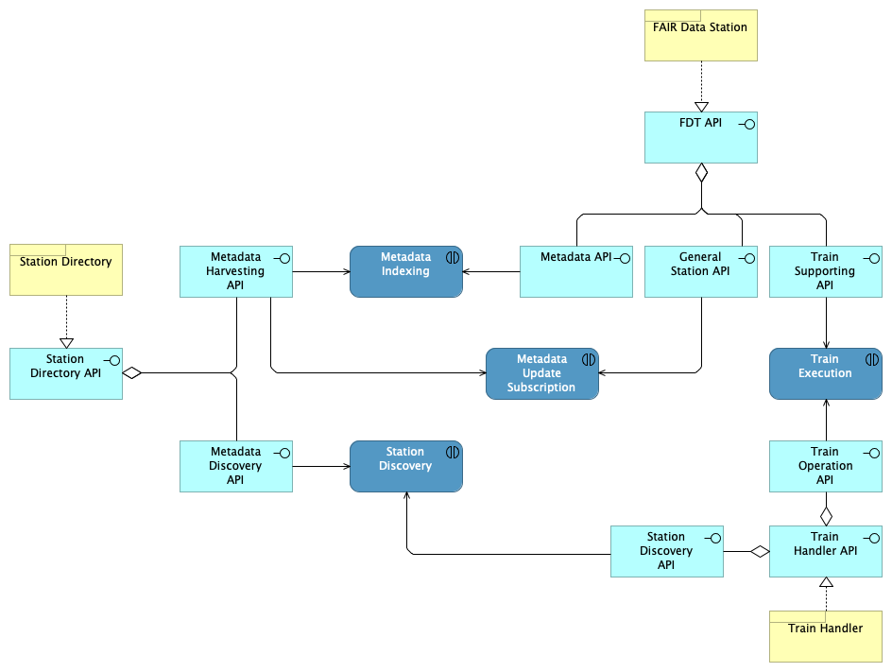
FDT – focus on minimal architecture requirements

Slide 18
FDT – focus on minimal architecture requirements
Aggrements on:
metadata access
metadata format
minimal metadata schema
data visiting API
metadata access
metadata format
minimal metadata schema
metadata access
data visiting API
metadata access

Slide 19
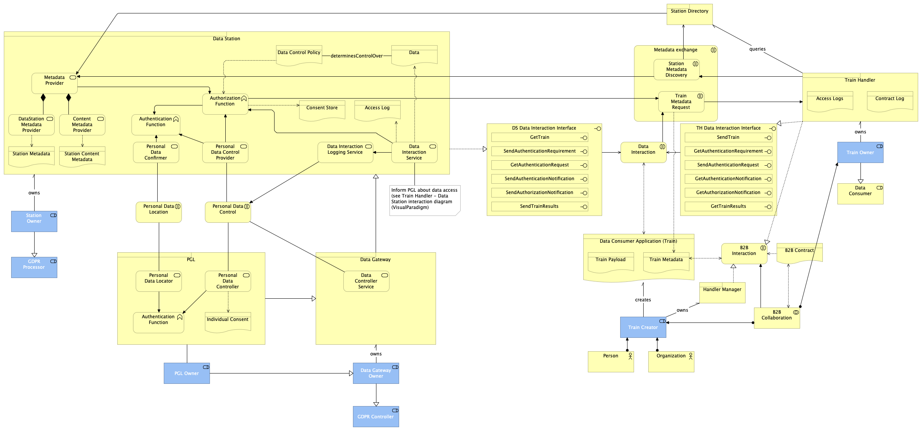
FDT (more) Detailed architecture (for reference of the expected functionality)

Slide 20


Data station metadata
Provenance
Who controls
Contact information
...
Capabilities
Supported interaction
Computing capacity
...
<Data Station>
Data Source
Information System
General
Name
Description
License
...
Station
Metadata
Name
Description
License
Semantic data model
...
Dataset(s)
Metadata

Slide 21
Train metadata
Provenance
Who created
...
Requirements
Data (input, output)
Computing capacity
General
Name
Description
Who controls
...
...
License
Interaction mechanism
<Train>
Analysis Algorithm
Train
Metadata

Slide 22
Train-station matching
Provenance
Who created
...
Requirements
Data (input, output)
Computing capacity
General
Name
Description
Who controls
...
...
License
Interaction mechanism
Provenance
Who controls
Contact information
...
Capabilities
Supported interaction
Computing capacity
...
General
Name
Description
License
...
Train
Metadata
Station
Metadata
Name
Description
License
Semantic data model
...
Dataset(s)
Metadata

Slide 23








C4yourself approach
<TrainHandler>
Client Application
<Train>
Analysis Algorithm
Train
Metadata
Request
Metadata
<Data Station>
PGO Station
<Data Station>
IDS Station
<Data Station>
FAIR Data Station
Station
Metadata
Station
Metadata
Station
Metadata
API
API
API
metadata
FDP
API
metadata
FDP
API
metadata
FDT
API
data
system
data
IDS
API
data

Slide 24
FAIR Data Station – prototype implementation
Metadata API
Station API
Metadata API
Station API
backend connection
Data Station-PGO System
backend connection
Data Station-IDS infra
system

Slide 25
FAIR Data Station - generic backend
Metadata API
Station API
backend connection Data Station-Backend System
Backend System
Backend System API

Slide 26
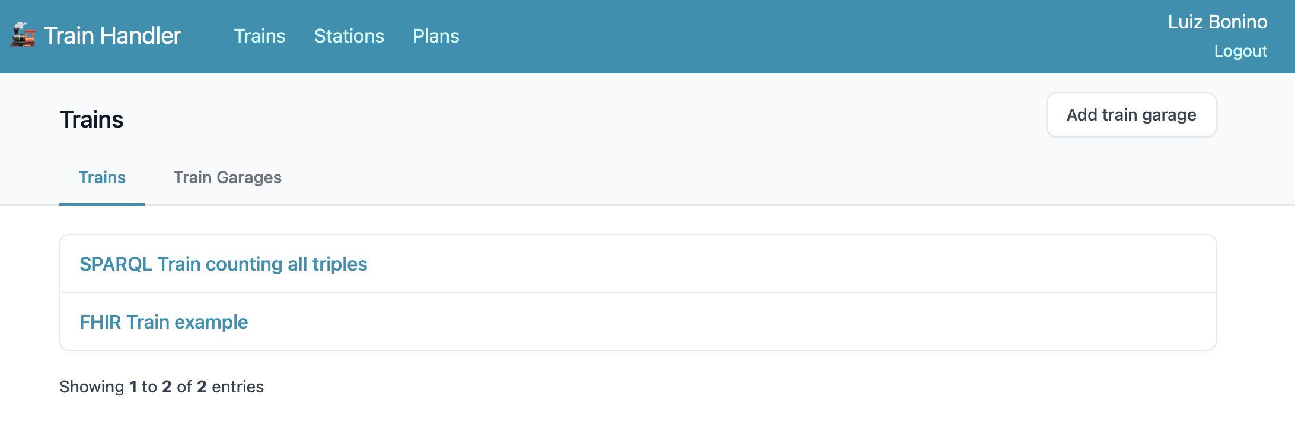
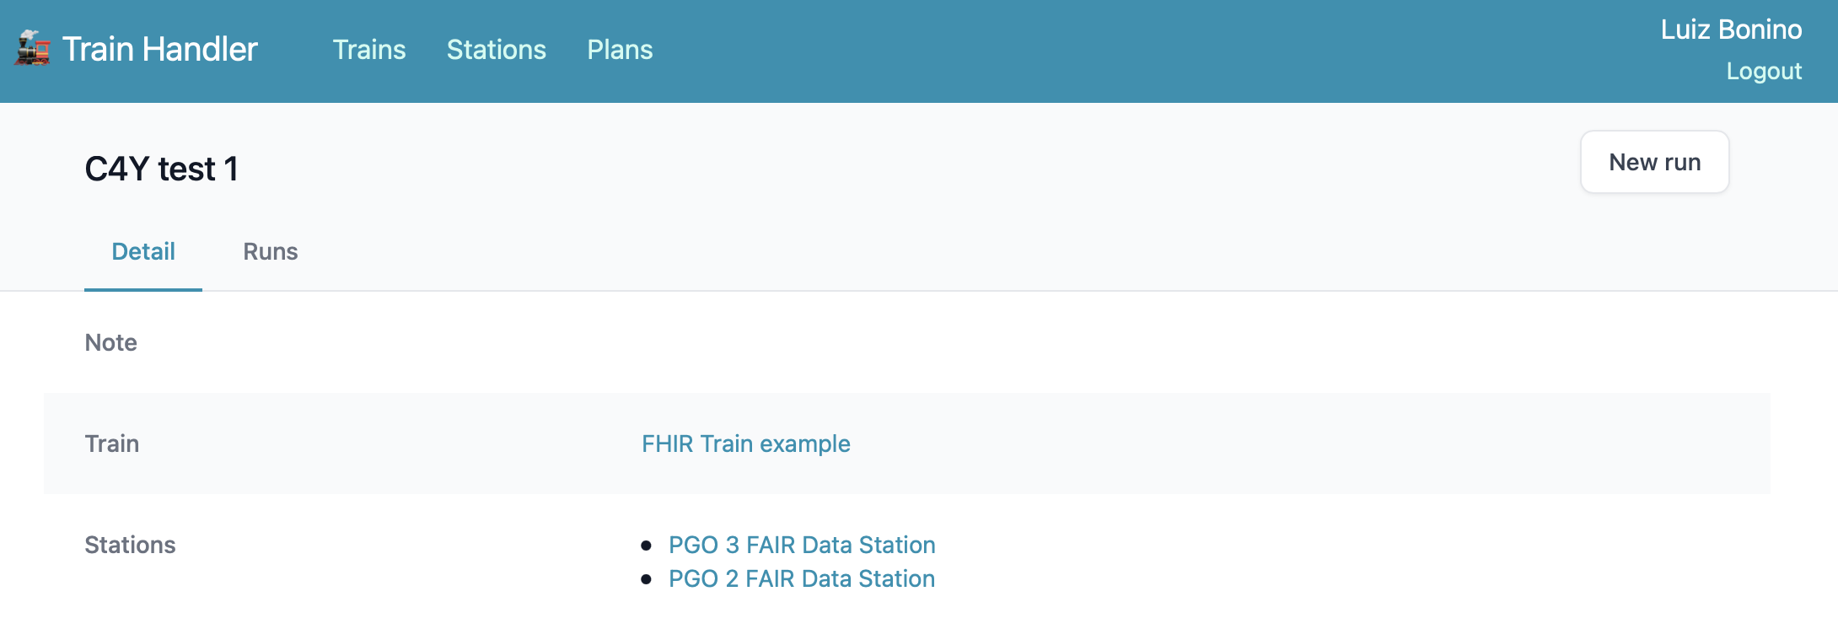
Client application

Slide 27
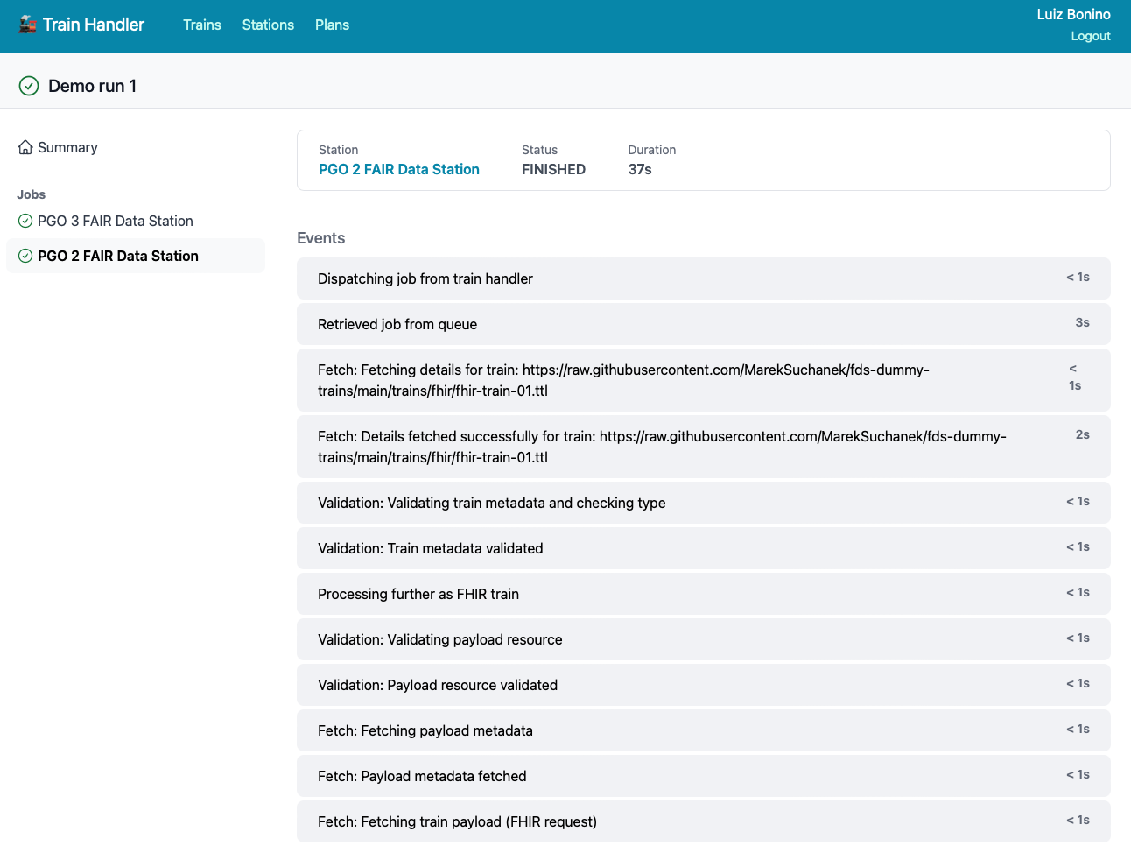
Train run 1/2

Slide 28
Train run 1/2
Train handler
Data station

Slide 29
Train run 1/2
Data consumer authentication and validation

Slide 30
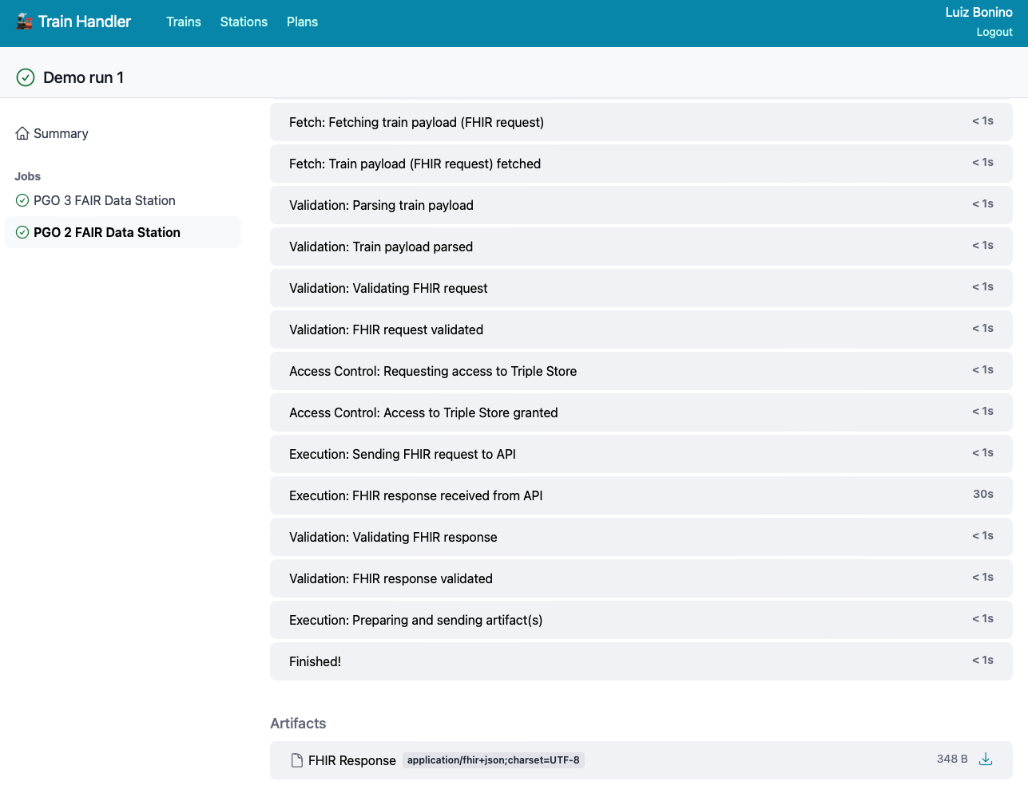
Train run 2/2
Train operation validation
Data access authorisation
Train output validation and authorisation
Train results

Slide 31
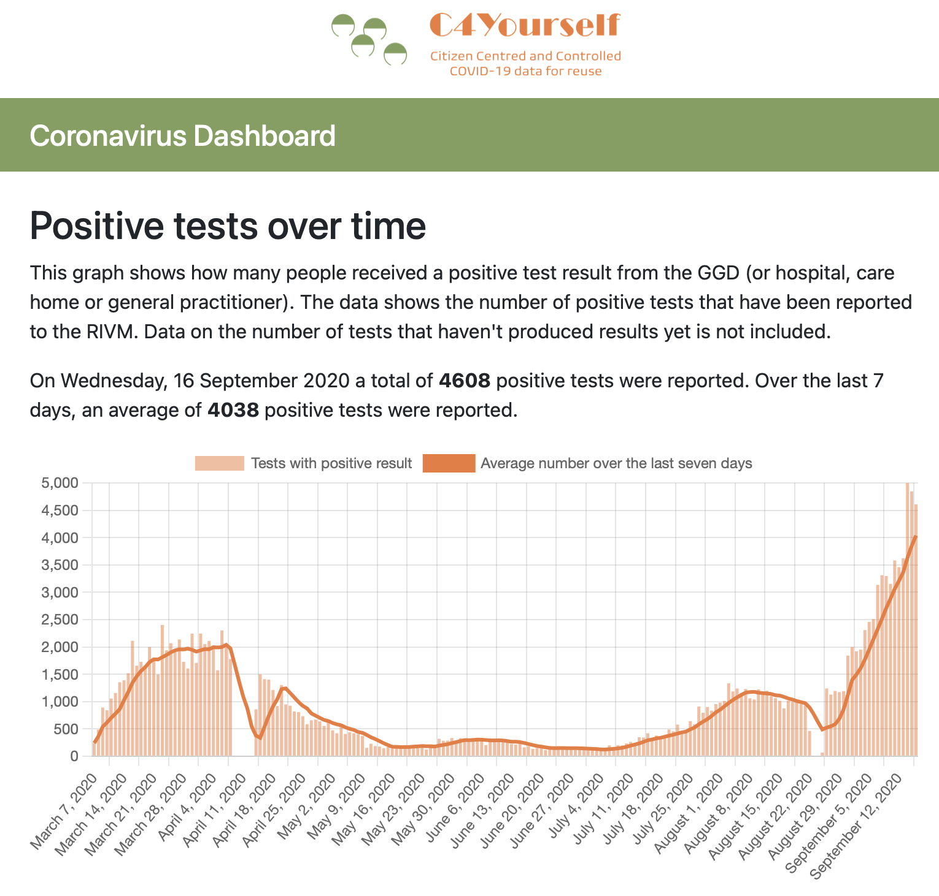
Train Results
https://dashboard.c4y.fairdatatrain.org

Slide 32
Privacy and security check points
Train arrive at the station:
Check train type x station support;
Check train compute requirements x station capabilities;
Check train’s data requirements x data availability at the station;
Train validated
Train data request
Check train’s data request x data accessibility conditions;
Check train owner x data accessibility conditions;
Train run approved
Train executed:
Check train results.
Return train results.

Slide 33
Contact info
Luiz Bonino
Associate Professor – SCS – U. Twente
Associate Professor – BioSemantics – LUMC
E-mail: l.o.boninodasilvasantos@utwente.nl
Skype: luizolavobonino

